Slide 1
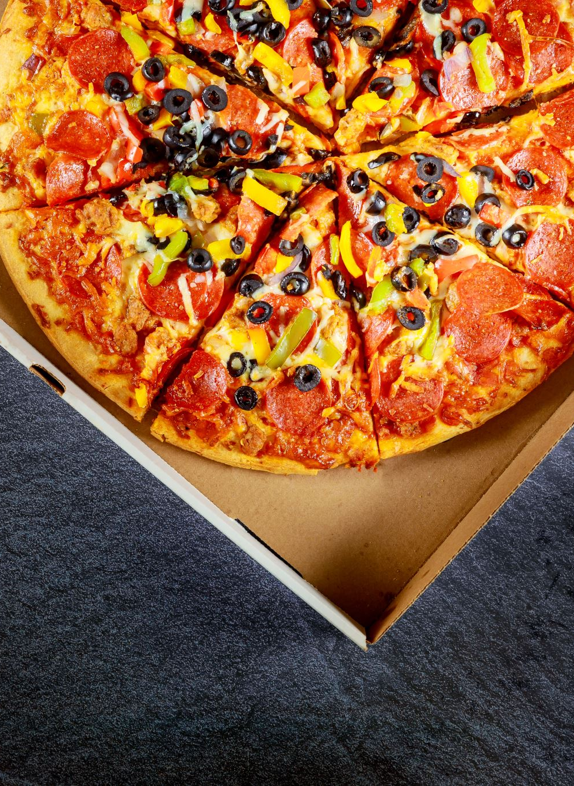
Pizza Hut Sales
SQL PROJECT

Slide 2

Overview about project
This project is designed to manage and track the operational processes of Pizza Hut, including handling customer orders, managing pizza details, and recording transaction specifics. It consists of four interconnected tables: orders, pizza_details, pizzas, and order_details.

Slide 3

Key Tables and Their Roles:
Orders Table:
Tracks customer orders and stores essential information.
Fields include:
order_id: Unique identifier for each order.
date: The date when the order was placed.
time: The time the order was placed.
Used to capture the timing of each customer’s order.

Slide 4
Pizza_Details Table:
Contains detailed information about each type of pizza offered.
Fields include:
pizza_type_id: Unique identifier for the type of pizza.
name: The name of the pizza (e.g., Margherita, Pepperoni).
category: Classifies the pizza (e.g., vegetarian, non-vegetarian).
ingredients: A list of ingredients for each pizza type.
Helps categorize pizzas and provides detailed menu information for customers and management.

Slide 5
Pizzas Table:
Defines the available pizza variations (in terms of size and price).
Fields include:
pizza_id: Unique identifier for each specific pizza.
pizza_type_id: Links the pizza to a type from the pizza_details table.
size: Specifies the size of the pizza (e.g., small, medium, large).
price: The price of the pizza based on its size.
Provides information for different pizza sizes and their corresponding prices, enabling flexible pricing options for customers.

Slide 6
Order_Details Table:
Records the specific pizzas ordered, along with their quantities.
Fields include:
order_details_id: Unique identifier for each order detail entry.
order_id: Links to the relevant order in the orders table.
pizza_id: References the pizza from the pizzas table.
quantity: Specifies how many of each pizza was ordered.
Acts as a junction table to capture the detailed breakdown of each order.

Slide 7

Project Workflow:
Order Placement: Customers place their orders, selecting pizzas of different sizes and quantities.
Order Recording: The orders table records when the order was placed (date and time), while the order_details table stores the specific pizzas ordered and their quantities.
Pizza Information: The pizza_details table provides detailed information about pizza types, including ingredients and categories, while the pizzas table records variations in size and price.
Order Management: The system manages and tracks each order, ensuring an organized structure for customer satisfaction and inventory management.
This database system ensures a smooth and organized process for managing orders, pizza details, and order transactions, making it easier for Pizza Hut to handle its day-to-day operations.

Slide 8
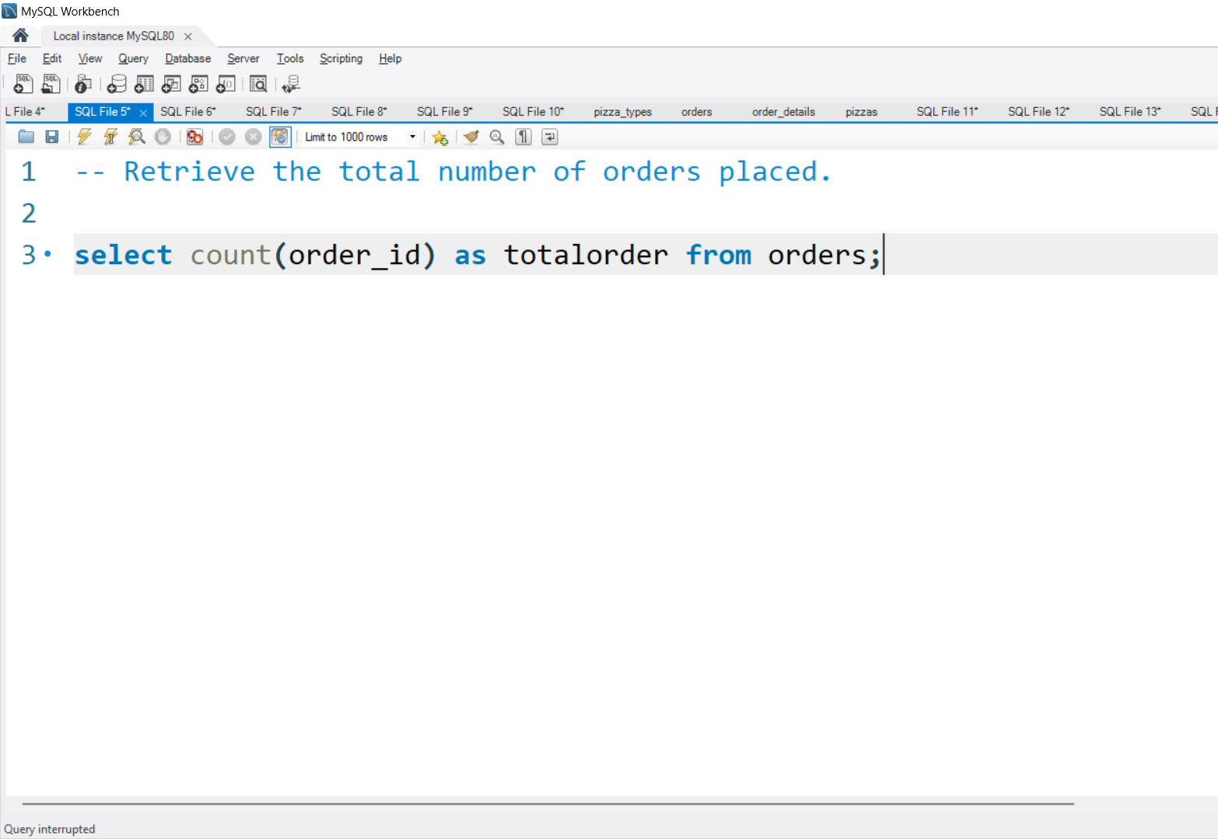

Retrieve the total number of orders placed.

Slide 9
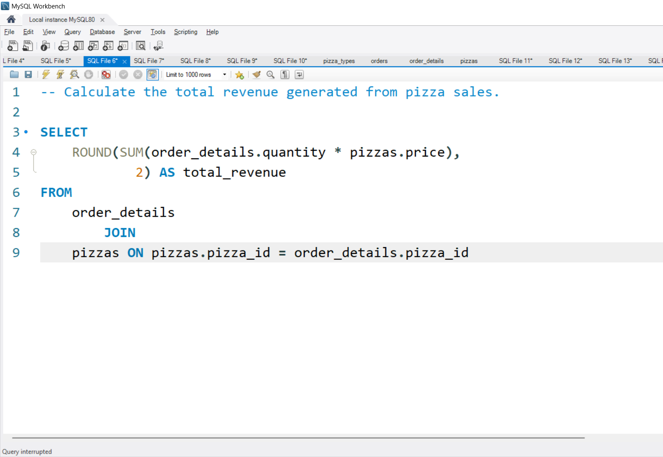
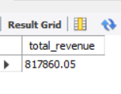
Calculate the total revenue generated from pizza sales.

Slide 10
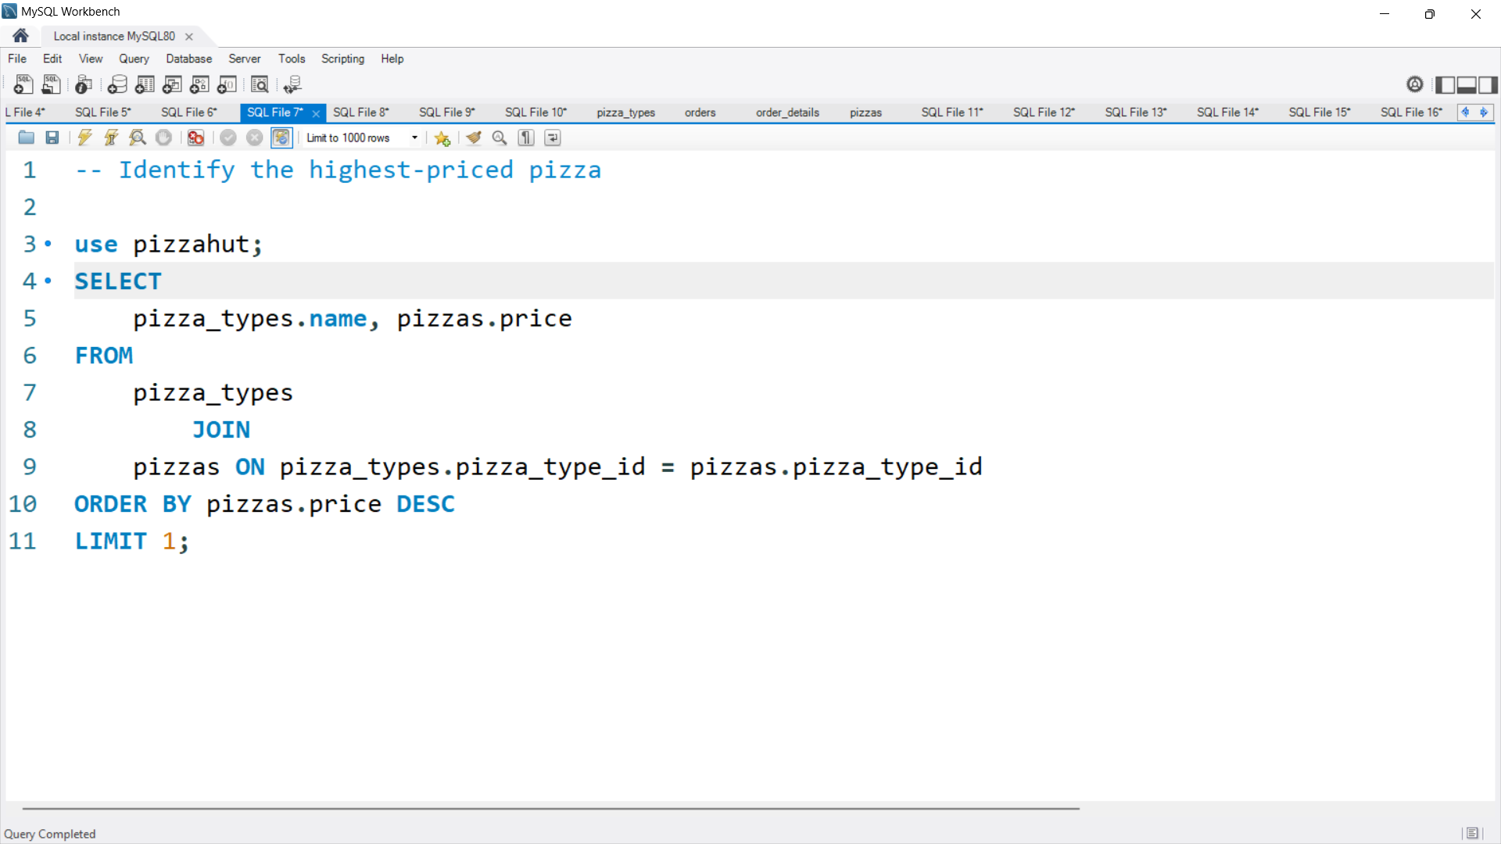
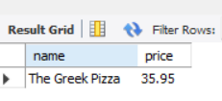
Identify the highest-priced pizza.

Slide 11
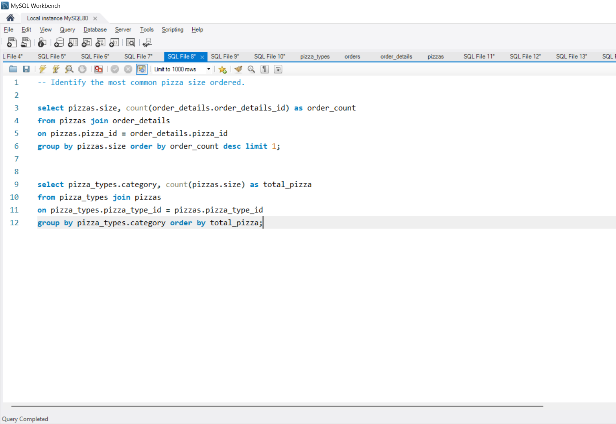
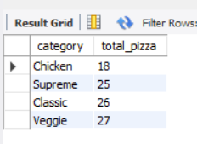
Identify the most common pizza size ordered.

Slide 12
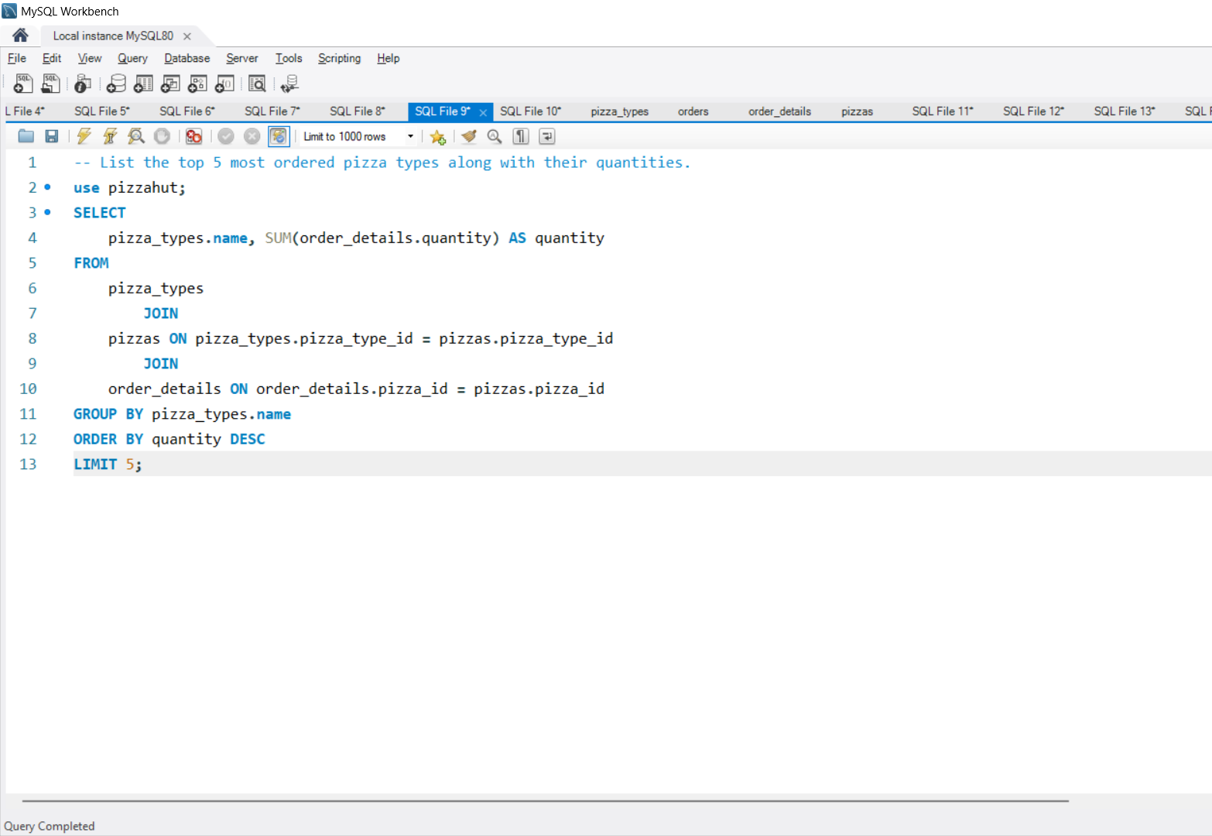
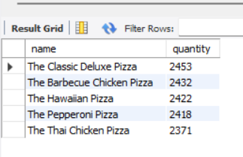
List the top 5 most ordered pizza types along with their quantities.

Slide 13
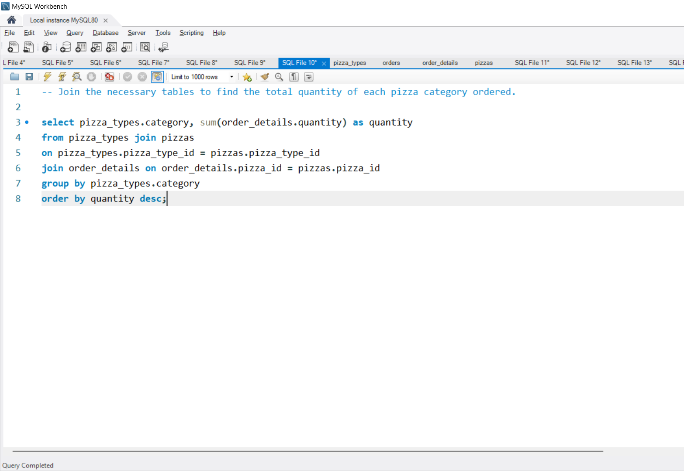
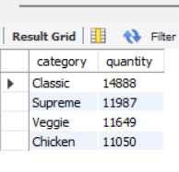
Join the necessary tables to find the total quantity of each pizza category ordered.

Slide 14
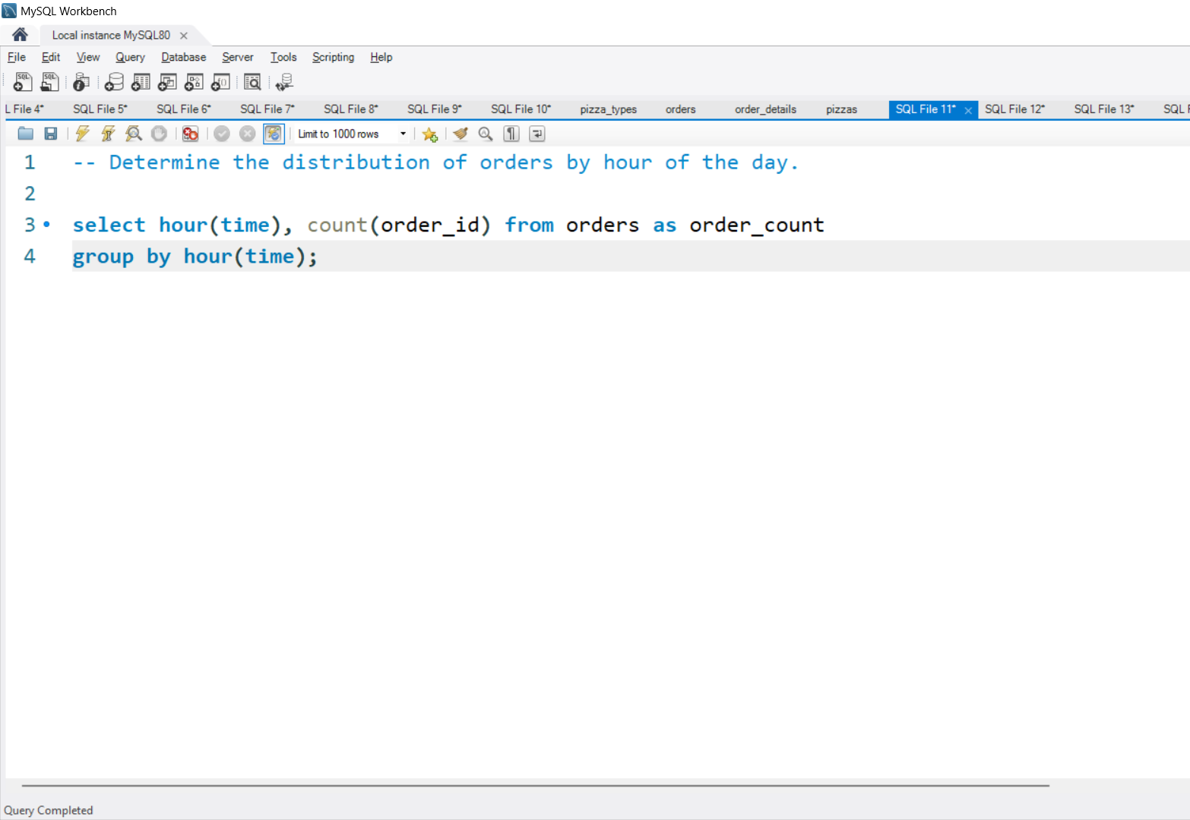
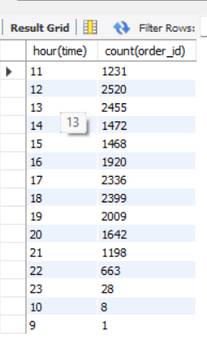
Determine the distribution of orders by hour of the day.

Slide 15
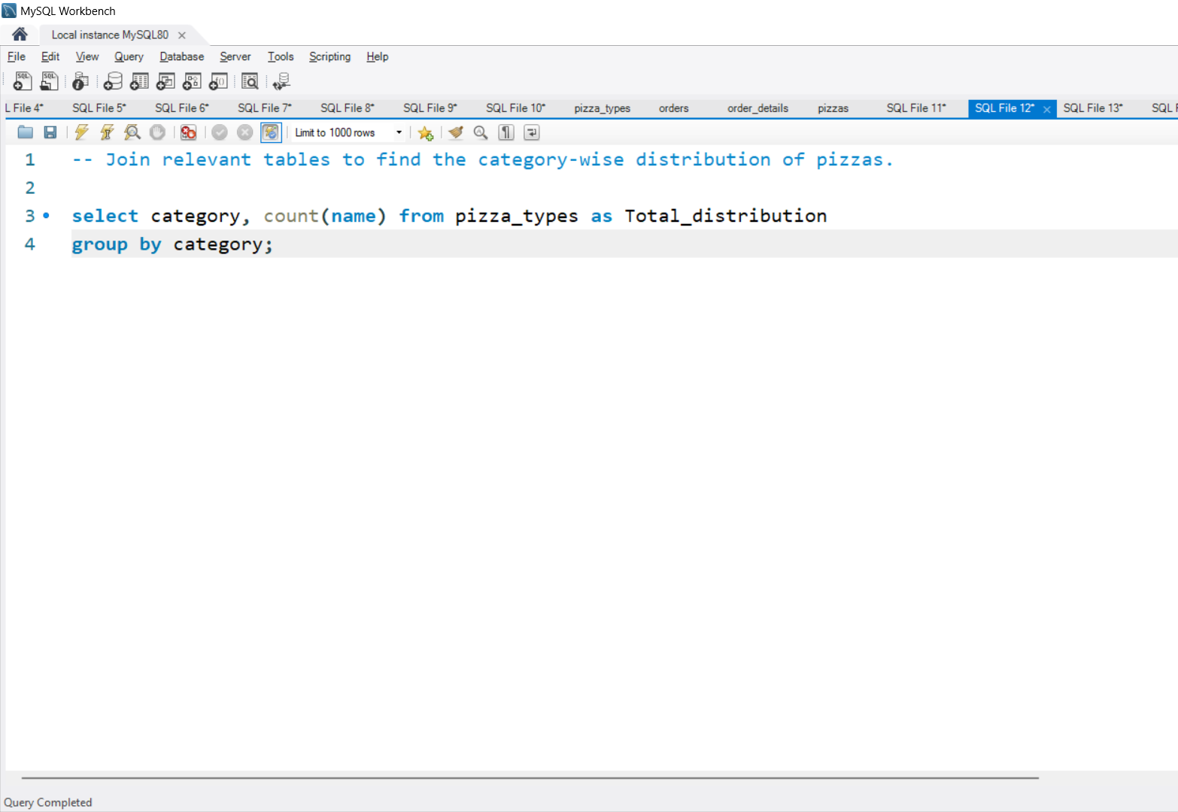
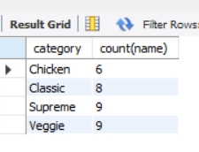
Join relevant tables to find the category-wise distribution of pizzas.

Slide 16
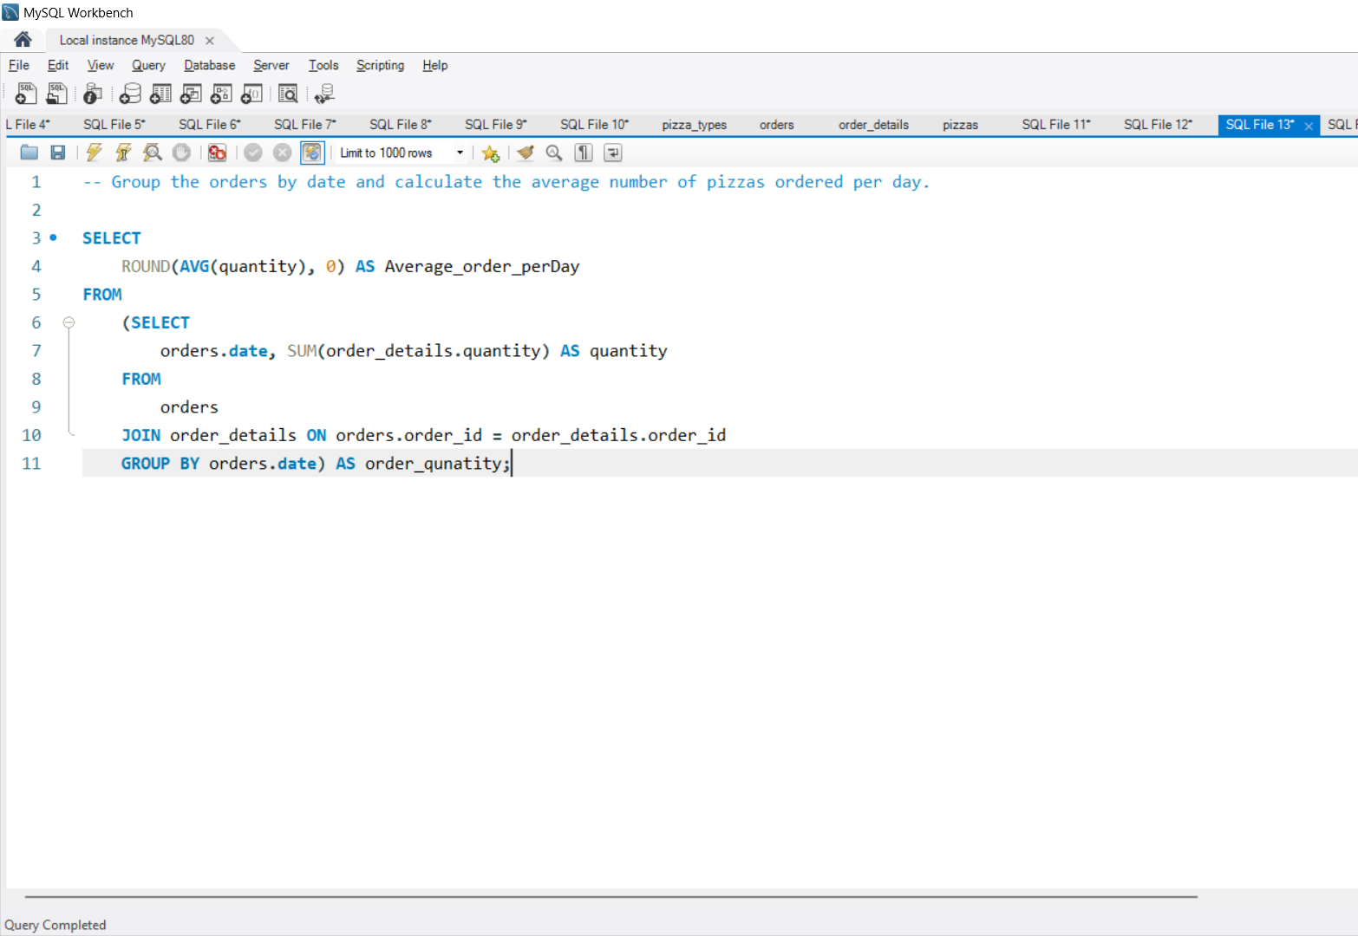
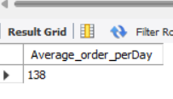
Group the orders by date and calculate the average number of pizzas ordered per day.

Slide 17
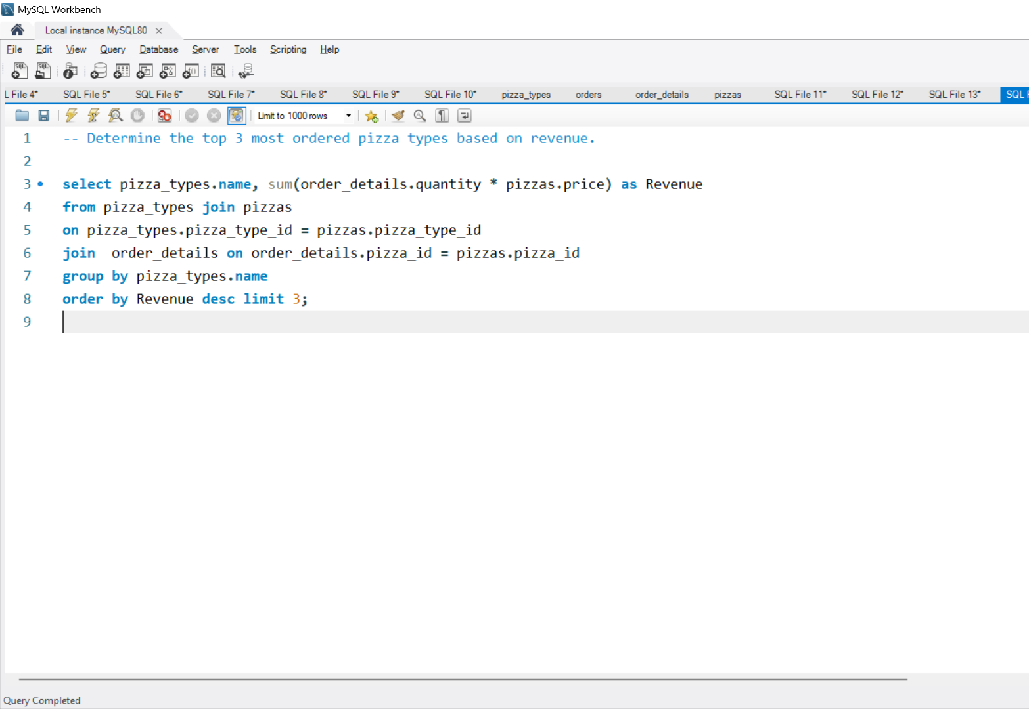
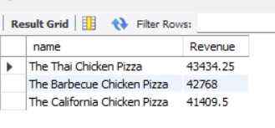
Determine the top 3 most ordered pizza types based on revenue.

Slide 18
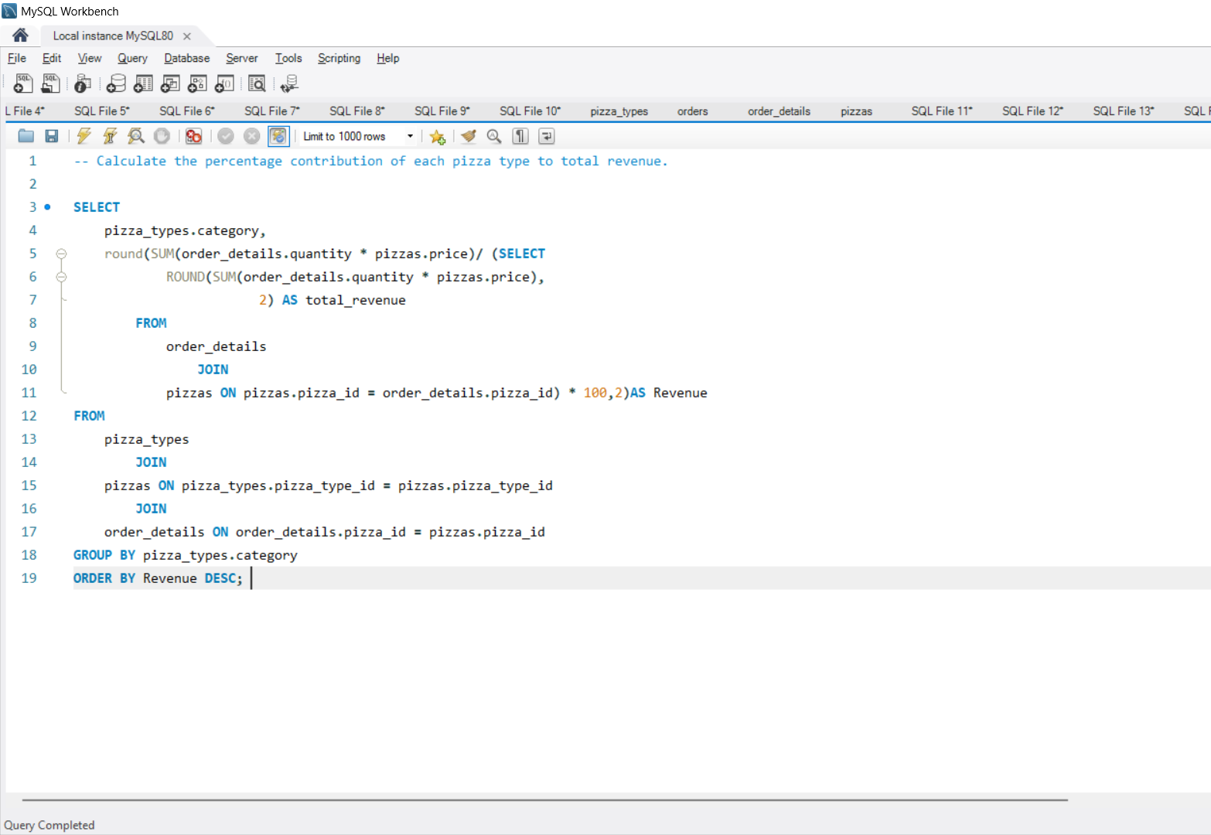
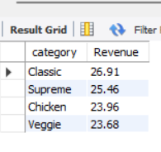
Calculate the percentage contribution of each pizza type to total revenue.

Slide 19
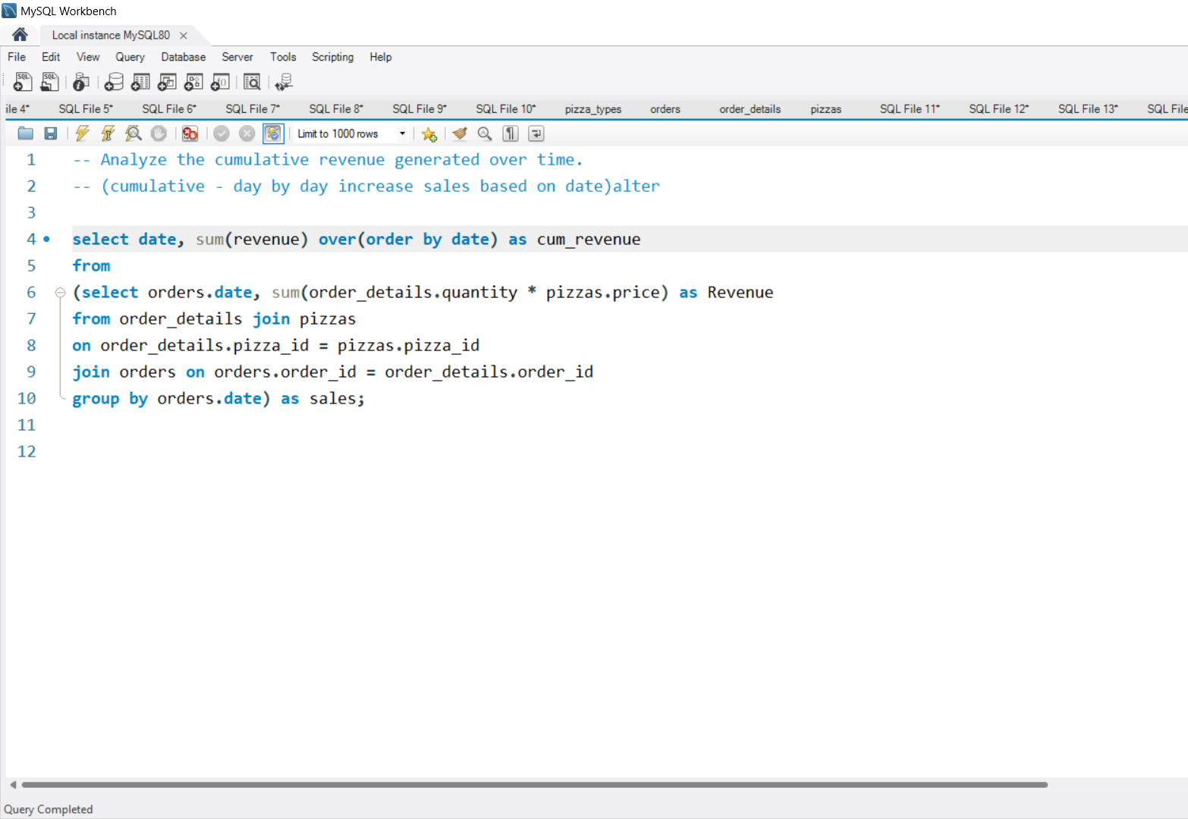
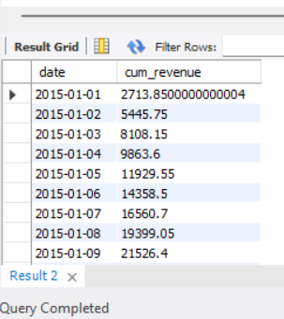
Analyze the cumulative revenue generated over time.

Slide 20
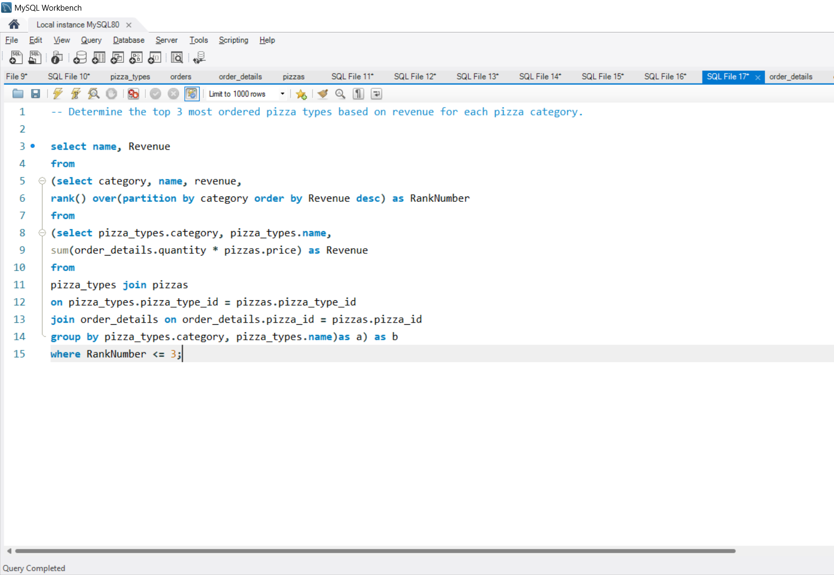
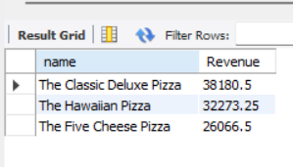
Determine the top 3 most ordered pizza types based on revenue for each pizza category.

Slide 21
Conclusion
In conclusion, this Pizza Hut Database Management System is designed to streamline the process of managing customer orders, pizzas, and detailed order records. By utilizing a well-structured database, we are able to:
Efficiently track orders, pizzas, and customer preferences.
Manage pizza details, including ingredients, categories, and pricing.
Maintain a clear record of all transactions for better order fulfillment and customer satisfaction.
This system not only enhances operational efficiency but also provides the foundation for future enhancements such as:
Real-time order tracking.
Improved customer insights and analytics.
Seamless integration with online ordering systems.
Thank you for your attention!

